Slide 1
Health insurance open enrollment
Insights for digital marketers

Slide 2
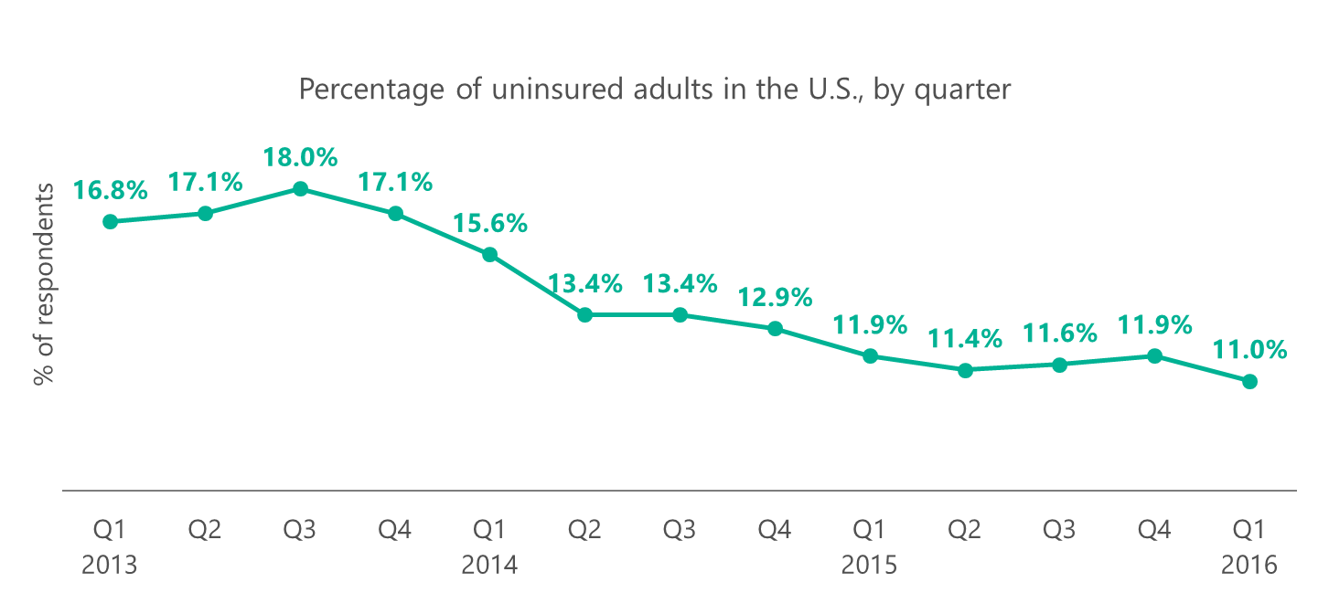
The Affordable Care Act (ACA) has taken a bite out of the uninsured rate
The rate of uninsured Americans has dropped 36% since the individual mandate came into affect in late 2013.
Source: Gallup, U.S. Uninsured Rate at 11.0%, Lowest in Eight-Year Trend, April 7, 2016.

Slide 3
For health insurance advertisers, fall and winter are when things really heat up
Campaigns need to be ready for the open enrollments.
Healthcare.gov and state marketplaces
2017 Open Enrollment:
November 1, 2016 to January 31, 2017¹
Medicare²
Open Enrollment: October 15 to December 7 All current subscribers
Change from Original Medicare (Parts A & B) to a Medicare Advantage Plan (Part C), or vice versa.
Switch from one Medicare Advantage Plan to another.
Join, change, or drop a Prescription Drug Plan (Part D).
General Enrollment: January 1 to March 31 First-time subscribers
Start a new policy (Parts A & B).
Advantage Disenrollment: January 1 to February 14 Advantage Plan subscribers
Change from a Medicare Advantage Plan to Original Medicare.
Join a Prescription Drug Plan.
Sources: 1. Centers for Medicare & Medicaid Services (CMS), CMS Finalizes Improvements for the 2017 Health Insurance Marketplaces, February 29, 2016.
2. ¹MedicareAdvantageSupplementPlans.com, The Different Medicare Enrollment Periods Explained, accessed April 11, 2016.

Slide 4
Advertising takeaways for the 2017 open enrollment periods
Have your ACA campaigns ready for October and Medicare ready in September when searches start to rise
Plan your budgets accordingly to attract searchers throughout the open enrollments
Bid on your own brand terms to get more clicks for you and less for your competitors
Leverage ad targeting and extensions to help your ads and message stand out
Bid on Healthcare.gov, ACA, and Medicare related terms

Slide 5
Checking up on the healthcare market
ACA open enrollment period
Who’s enrolling
How are they choosing plans
When are they enrolling
Medicare enrollment periods
How big is the opportunity
What’s happening with Medicare Advantage
Healthcare digital ad spending

Slide 6
The ACA marketplaces are hitting their stride
20 million American adults gained health insurance since the Affordable Care Act (ACA, aka ‘Obamacare’) individual mandate took effect in early 2014¹
12.7 million Americans signed up for or renewed health insurance plans during the third ACA Open Enrollment period from November 1, 2015 to January 31, 2016²
4.9 million New customers signed up for coverage in the third Open Enrollment period²
Sources: 1. U.S. Department of Health and Human Services (HHS), Health Insurance Coverage and the Affordable Care Act, 2010 – 2016, March 3, 2016. 2. HHS, Health Insurance Marketplaces 2016 Open Enrollment Period: Final Enrollment Report, March 11, 2016.

Slide 7
They also face some obstacles
Consumers are looking on and off the marketplaces.
Fewer marketplace choices If a new entrant does not replace United Healthcare in the markets it’s exiting:
1.8M enrollees will have choice of two insurers, and 1.1M enrollees will have a choice of single insurer.¹
TIP
Know your markets and competitors.
Expect less competition in the southern U.S. where fewer insurers are participating in the ACA marketplaces.
More short-term coverage Insurers are reporting an increase in Americans choosing short-term plans (up to 11 months) over marketplace plans.² Short-term plans may come with cheaper premiums, but they may not comply with the individual mandate.
TIP
Highlight your competitive pricing and the availability of subsidies to lure people back to marketplace plans.
Inform consumers about the individual mandate tax penalty to help them understand the true cost of short-term plans.
Legislation and litigation Uncertainty surrounds the ACA due to efforts to dismantle it through laws and lawsuits.
Sources: 1. Kaiser Health News, Competition Suffers Most if United Healthcare Exits Obamacare in 2017: Analysis, April 18, 2016.
2. Wall Street Journal, Sales of Short-Term Health Policies Surge, April 10, 2016.

Slide 8
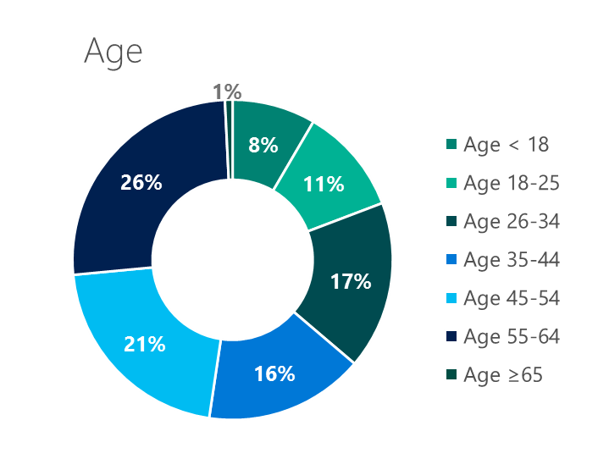
People across the country are signing up
Urban women ages 45-64 are most likely to sign up for coverage.
Zip code
18%
^{rural}
82%
^{urban}
Gender
46%
^{male}
54%
^{female}
TIP
Leverage demographic targeting to hit your audience.
Source: HHS, Health Insurance Marketplaces 2016 Open Enrollment Period: Final Enrollment Report, March 11, 2016.

Slide 9
People are coming back year after year
Re-enrollees outnumbered new enrollees for the first time in the 2016 Open Enrollment period – 58% to 42%.
Re-enrollees actively looked at new plan options before signing on for another year.
70%
Re-enrollees switched plans. This is a higher proportion than in other healthcare programs, including Medicare.
43%
TIP
Don’t ignore this group. Use UET/ Remarketing to target your existing customer base who want to compare options before re-enrolling.
Source: HHS, Health Insurance Marketplaces 2016 Open Enrollment Period: Final Enrollment Report, March 11, 2016.

Slide 10
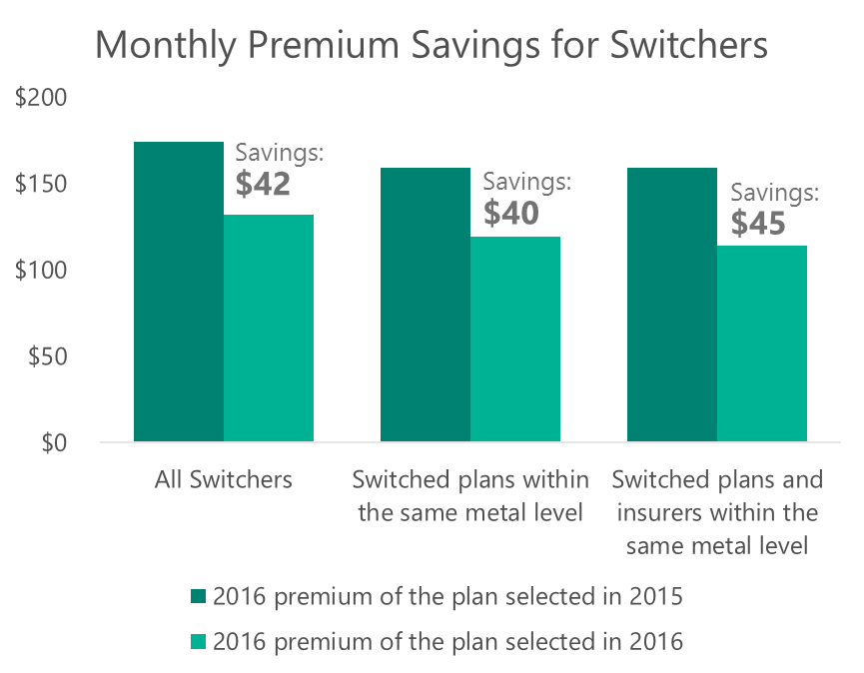
Re-enrollees are looking for savings
Re-enrollees are likely to save on their monthly premiums by switching plans, and more when switching insurers.
64%
Switchers changed insurers
31%
Switchers changed
metal level
TIP
Use Callout Extensions to highlight your price advantage.
Source: HHS, Health Insurance Marketplaces 2016 Open Enrollment Period: Final Enrollment Report, March 11, 2016.

Slide 11
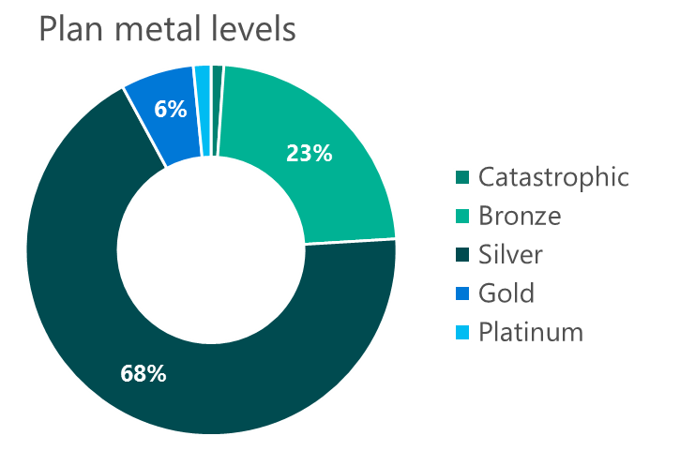
Consumers are choosing Silver plans
Silver plans offer consumers low premiums and moderate coverage. They’re popular with consumers receiving tax credits and subsidies.
TIP
Use your marketing efforts to help consumers learn more about their options and how your plans, networks and services compare with those of your competitors.
Source: HHS, Health Insurance Marketplaces 2016 Open Enrollment Period: Final Enrollment Report, March 11, 2016.

Slide 12
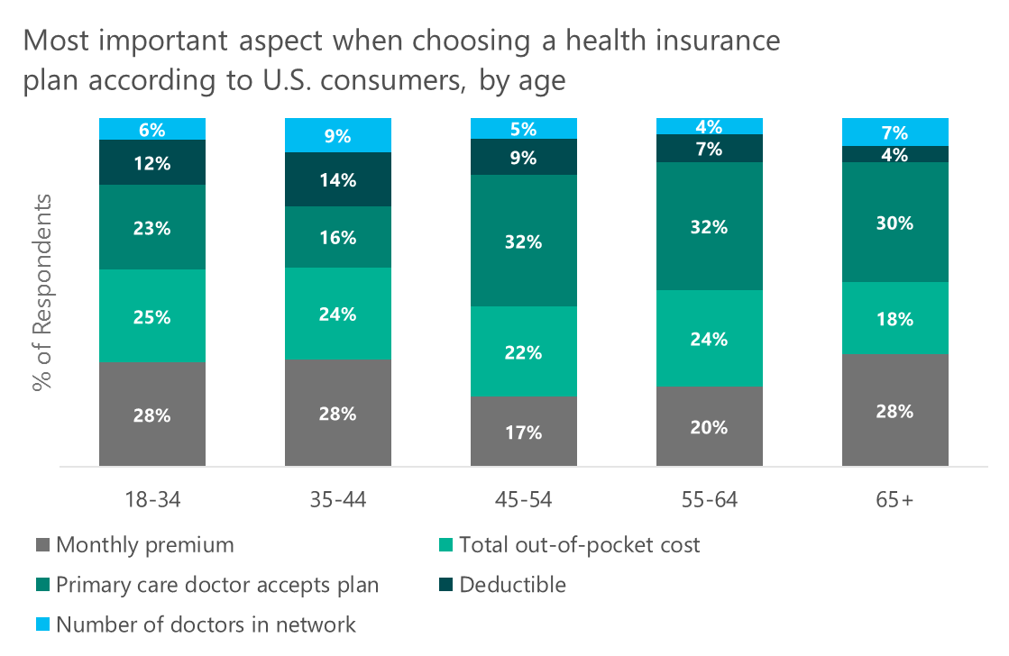
Money is a factor, but not for everyone
Younger consumers want to keep costs low, while older consumers want to keep their primary care doctors.
TIP
Use demographic targeting to present tailored ads to each group based on what plan aspects they care about.
Source: Fair Health, “Understanding Consumer Health Insurance Preferences”, conducted by ORC International, August 12, 2015.

Slide 13
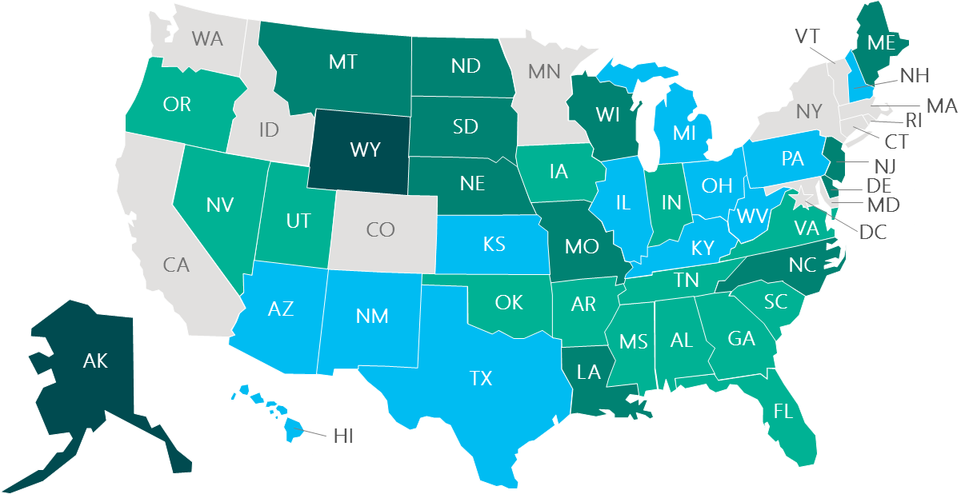
Premiums vary widely by state
Premiums in the costliest state (Alaska) can be double or triple that of the lowest cost states.
2016 average monthly premiums for second-lowest cost silver plans for a 27-year-old (before tax credits), in Healthcare.gov states
TIP
Location targeting is key to reaching state-specific audiences.
Below average (<$224)
Average ($225-$255)
Above average ($256-$350)
Highest (>$351)
No data, state-based marketplaces
Source: Microsoft internal analysis, based on HHS ASPE, ASPE Research Brief: Health Plan Choice and Premiums in the 2016 Health Insurance Marketplace, October 30, 2015.

Slide 14
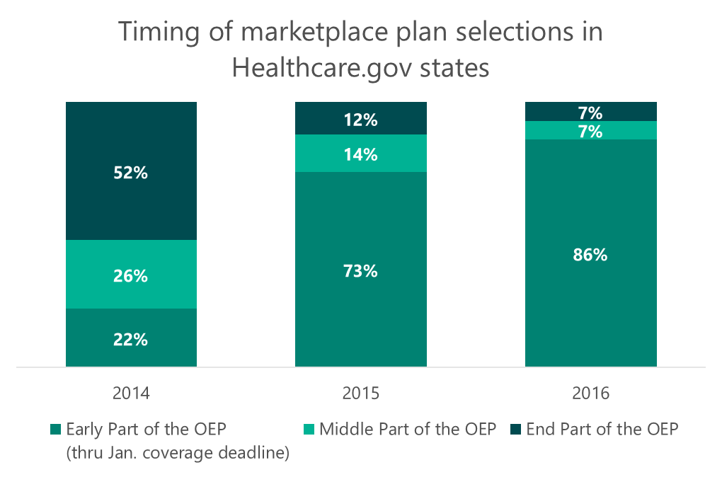
January coverage drives enrollment
As the marketplace matures, more people enroll and re‑enroll in plans early in the enrollment period.
TIP
Front-load your campaign budgets to capture customers who are shopping for a new plan before the January coverage and automatic re‑enrollment deadlines.
Note: In the 2016 Open Enrollment, the January coverage deadline and automatic reenrollments both occurred in Week 7.
Source: HHS, Health Insurance Marketplaces 2016 Open Enrollment Period: Final Enrollment Report, March 11, 2016.
2014: Early (10/1/13 to 12/28/13), Middle (12/29/13 to 3/1/14), End (3/2/14 to 3/31/14, including Special Enrollment Period [SEP] activity through 4/19/14); 2015: Early (11/15/14 to 12/26/14), Middle (12/27/14 to 2/6/15), End (2/7/15 to 2/15/15, including SEP activity through 2/22/15); 2016: Early (11/1/15 to 12/19/15), Middle (12/20/15 to 1/23/16), End (1/24/16 to 2/1/16).

Slide 15
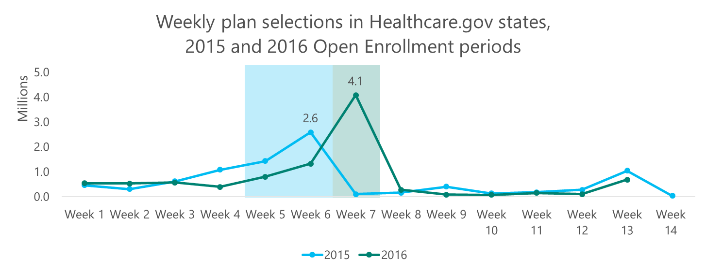
And enrollees respond to deadlines
Selections peak around the January coverage deadlines and again at the end of the enrollment period.
TIP
Leave some budget to make it through January. Enrollment may peak in December, but searches peak in January.
Notes: 2015 Open Enrollment - Nov. 15, 2014 to Feb. 22, 2015; 2016 Open Enrollment - Nov. 1, 2015 to Feb. 1, 2016; Batch Automatic Reenrollments: 2015 Week 6, 2016 Week 7; January coverage deadline: 2015 Week 4 (Dec. 15, 2014); 2016 Week 7 (Dec. 17, 2015).
Source: HHS, Health Insurance Marketplaces 2016 Open Enrollment Period: Final Enrollment Report, March 11, 2016.

Slide 16
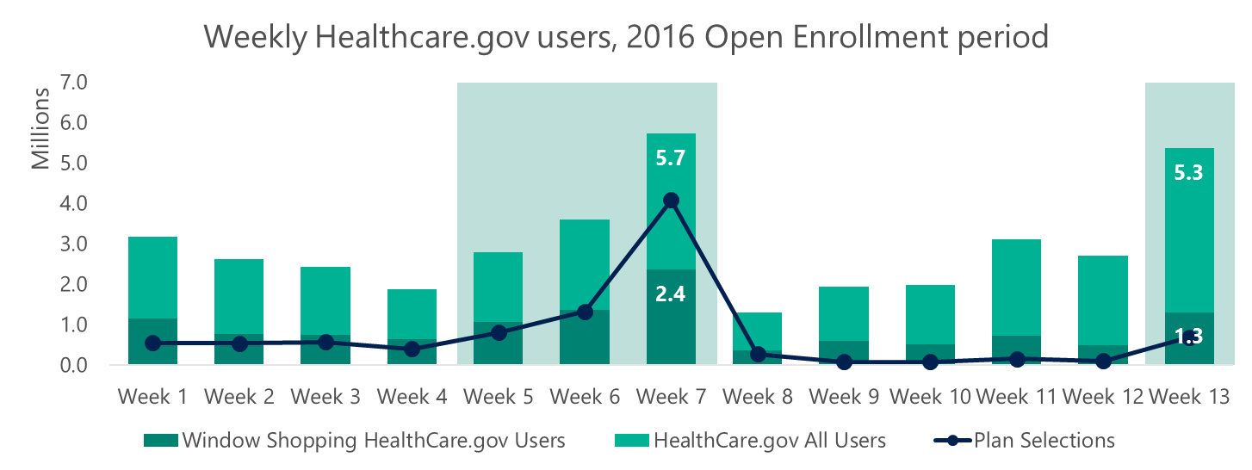
Healthcare.gov visits align with selections
More than 31M people visited the site during the 2016 Open Enrollment Period, completing 9.6M applications.
TIP
Use UET/Remarketing to target the window shoppers who visit your site early in the Open Enrollment Period and return before selecting their plans.
Note: 2016 Open Enrollment - Nov. 1, 2015 to Feb. 1, 2016; Week 7 represents the January coverage deadline and batch automatic reenrollment cutoff.
Source: HHS, Health Insurance Marketplaces 2016 Open Enrollment Period: Final Enrollment Report, March 11, 2016.

Slide 17
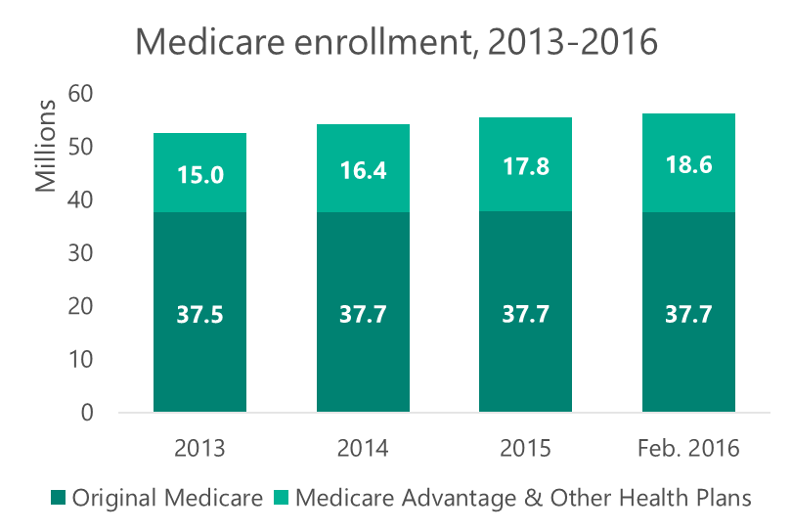
Don’t forget about the Medicare enrollment periods
More than 56.2M Americans rely on Medicare.
Source: CMS, Medicare Enrollment Dashboard, accessed April 14, 2016.

Slide 18
There’s opportunity for growth
1 in 10 seniors switch to a new Medicare medical and/or drug plan during the Medicare enrollment periods.^{1,2}
Too much hassle
Although seniors may save money by switching to new plans, seniors found the process of choosing a plan “frustrating,” “confusing” and “overwhelming.”²
TIP
Address the hassle up front. Use Sitelink and Enhanced Sitelink Extensions to highlight any plan comparison guides you have to help seniors and their caregivers select replacement plans with greater ease.
Help Medicare searchers connect with customer service and support by using Call Extensions.
Bigger outlays
Premiums in Medicare plans and out-of-pocket costs in drug plans are expected to rise in the near term – giving seniors incentive to shop around.²
Sources: 1. CNBC, Medicare drug plan prices set to rise in 2016, some by a lot, September 29, 2015.
2. Kaiser Health News, Seniors Who Don’t Consider Switching Drug Plans May Face Steep Price Rise, October 20, 2015.

Slide 19
Traditional insurers aren’t alone
Provider-sponsored plans are a growing part of the Medicare Advantage equation.
70
TIP
Optimize your campaigns for your local and regional markets – to combat your local competitors. Be clear about what makes your plans, networks, and services the best around.
^{Provider-sponsored} ^{parent organizations}
in
41
^{states}
35 million
offering
Medicare beneficiaries can choose one of these plans
403
^{Medicare Advantage plans}
Source: Avalere Health, Nearly 60 Percent of New Medicare Advantage Plans are Sponsored by Healthcare Providers, January 26, 2016

Slide 20
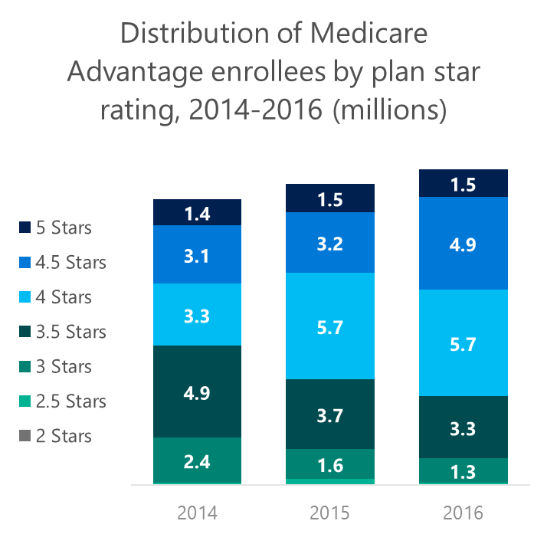
Reputation matters for seniors
Seniors look for higher quality Medicare Advantage plans. 72% of enrollees are in a plan with 4 or more stars.
TIP
Use Callout Extensions to highlight your higher quality plans, your brand reputation and your provider network.
30% year-over-year increase in 4.5 star plan enrollment
Source: Avalere Health, More than 70 Percent of Medicare Advantage Enrollees in Plans with Four or More Stars, March 16, 2016

Slide 21
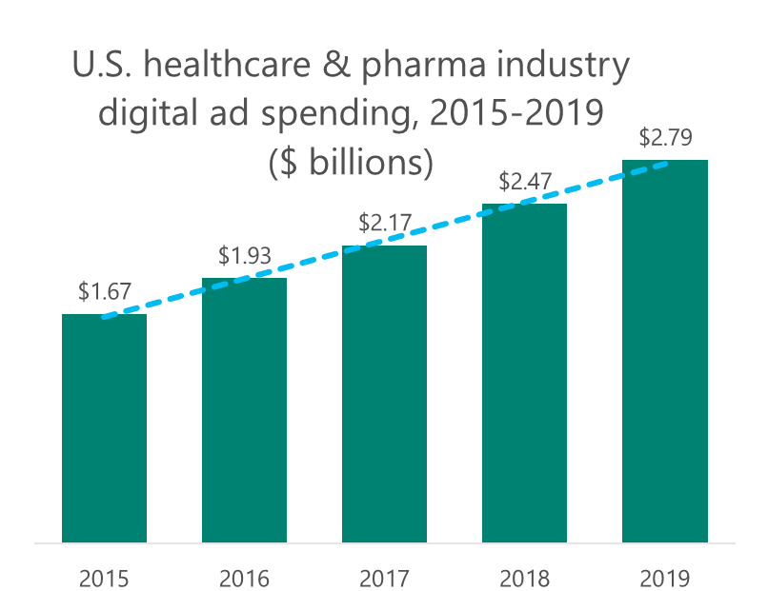
Healthcare digital ad spending is on the rise
What will you spend your ad dollars on?
Source: eMarketer. The US Healthcare and Pharmaceutical Industry Digital Ad Spending, March 2016.

Slide 22
The federal government doesn’t advertise
Neither do some states. This presents an opportunity for advertisers to bid on Healthcare.gov, ACA, and Medicare related keywords.

Slide 23
Bing Network performance trends

Slide 24
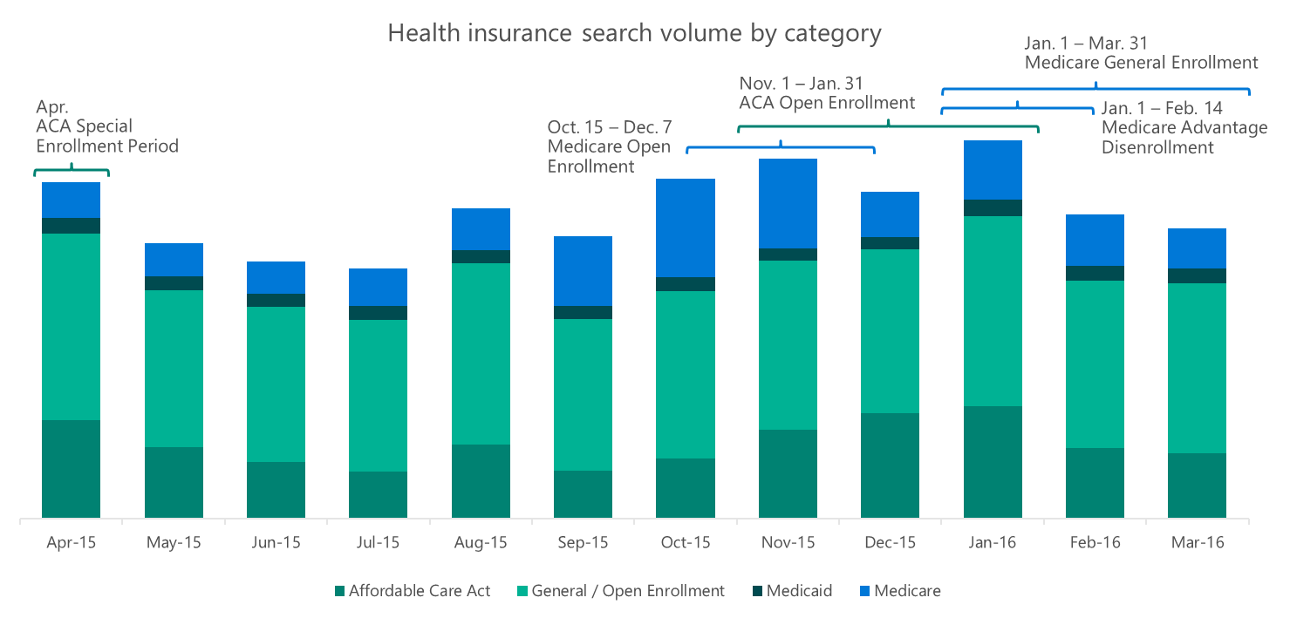
Pay attention to the enrollment periods
Searches peak around open enrollment periods and are strong throughout the year.
Source: Microsoft internal data Apr 2015 – Mar 2016, searches across all devices.

Slide 25
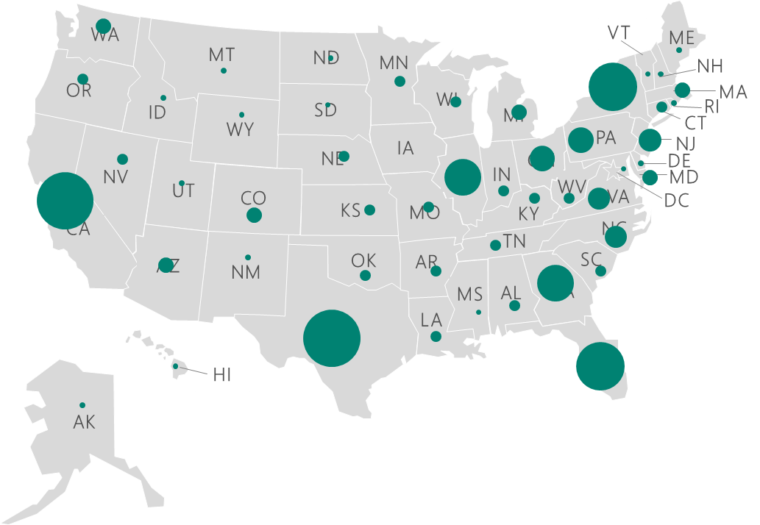
Ten states drove 43% of clicks nationwide
If you’re running regional campaigns, allocate more budget to states with higher clicks and CTR.
States | % Clicks | CTR | CPC
California | 7% | 2.3% | $2.06
Texas | 7% | 2.4% | $2.25
Florida | 5% | 2.5% | $2.39
New York | 5% | 3.2% | $2.29
Georgia | 4% | 3.3% | $2.37
Illinois | 4% | 2.9% | $2.05
Pennsylvania | 3% | 2.9% | $2.46
Ohio | 3% | 2.6% | $2.33
North Carolina | 3% | 2.8% | $2.39
Virginia | 3% | 3.0% | $2.28
Source: Microsoft internal data Apr 2015 – Mar 2016, searches across all devices.

Slide 26
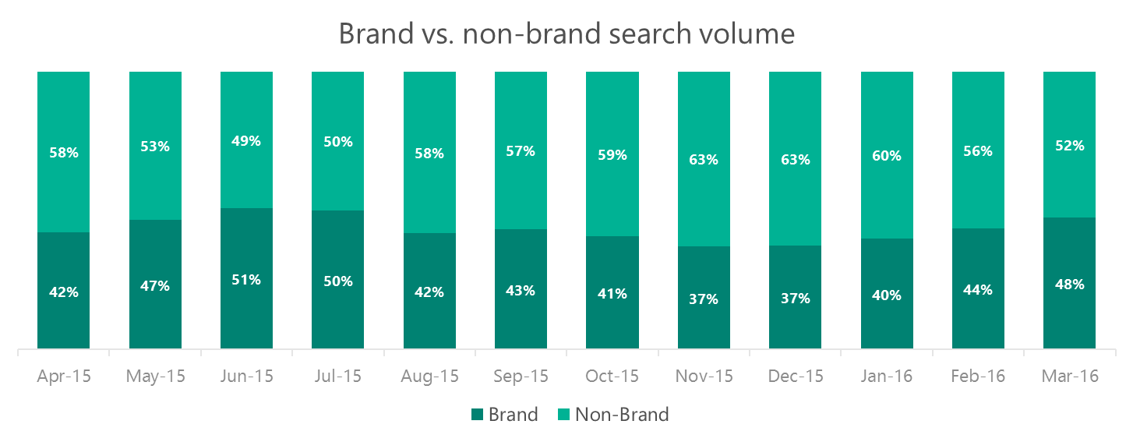
Play on brand loyalty to capture searchers
Nearly half of health insurance searches are for brands.
TIP
Bid on your own brand terms to get more clicks for you and fewer for your competitors.
Source: Microsoft internal data Apr 2015 – Mar 2016, searches across all devices.

Slide 27
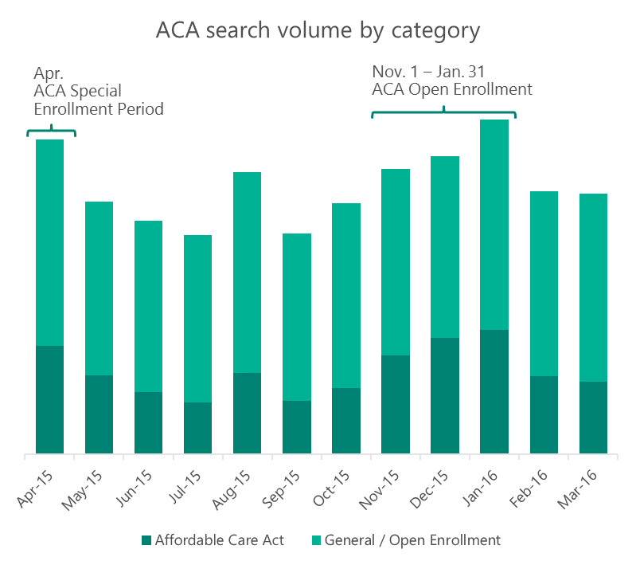
Budget to make it through the Jan. peak
Have your ACA campaigns ready as searches start rising in October and prepare for the last-minute January surge.
Top 10 ACA Search Terms:
healthcare gov
obamacare
kaiser permanente
covered california
affordable care act
healthcare marketplace
www healthcare gov
molina healthcare
health insurance marketplace
obama care
Top 10 Open/ General Enrollment Search Terms:
aarp
aetna
health insurance
blue cross blue shield
unitedhealthcare
humana
state farm insurance
united healthcare
nationwide insurance
anthem
Source: Microsoft internal data Apr 2015 – Mar 2016, searches across all devices.

Slide 28
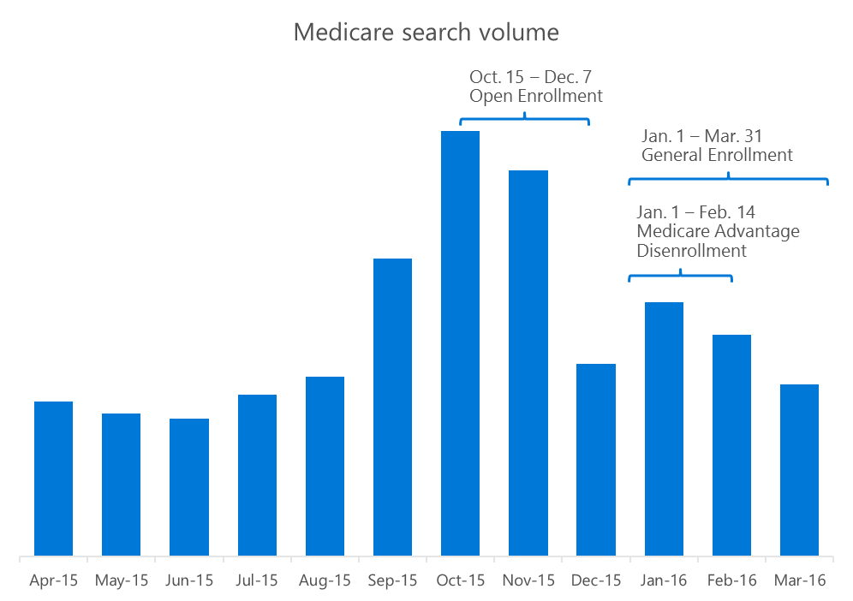
Ramp up your Medicare ads by September
Have your campaigns ready and optimized for seniors searching for options before Open Enrollment kicks off.
Top 10 Medicare Search Terms:
medicare gov
medicare supplemental insurance
medicare
medicare supplement insurance
medicare part d
mymedicare gov
medicare official website
www medicare gov
medicare part b
medicare supplement plan
Source: Microsoft internal data Apr 2015 – Mar 2016, searches across all devices on Medicare-related queries.

Slide 29
Words that work Ad copy analysis

Slide 30
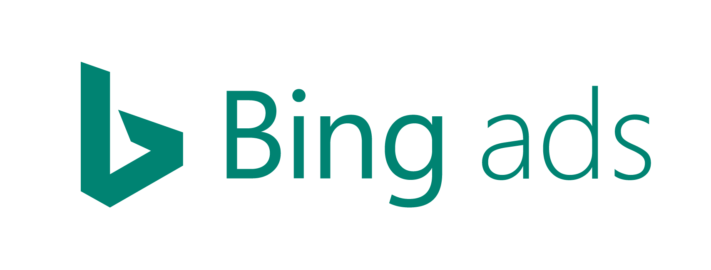
Here’s how to read a heat map
Great
Good
Bad
Insufficient data
 |  | AD DESCRIPTION
 |  | % Off | Availability | Benefits | Brand | Call to Action | Cheap / Affordable | Comparison | Coverage | Enrollment | Free | Health Care | Information | Insurance Type | Medicare | Online | Plans | Premium | Price / Pricing | Quote | Service | Superlative | Time
AD TITLE | Brand
 | Call to Action
 | Cheap / Affordable
 | Comparison
 | Coverage
 | DKI
 | Enrollment
 | Free
 | Health Care
 | Information
 | Insurance Type
 | Location
 | Medicare
 | Official
 | Online
 | Param Insertion
 | Plans
 | Premium
 | Price / Pricing
 | Quote
 | Senior
 | Superlative
 | Time
Our study results show that a Health Insurance with “Free” in the title and “Brand” in the description presents high Ad Quality performance.
Source: Microsoft Internal Data. Total Impressions Generated = 30 Million, Total Ads Analyzed = 56k, Analysis Period = 16 August 2015 – 31 January 2016.
Note: These categories represent groups of similar keywords.

Slide 31
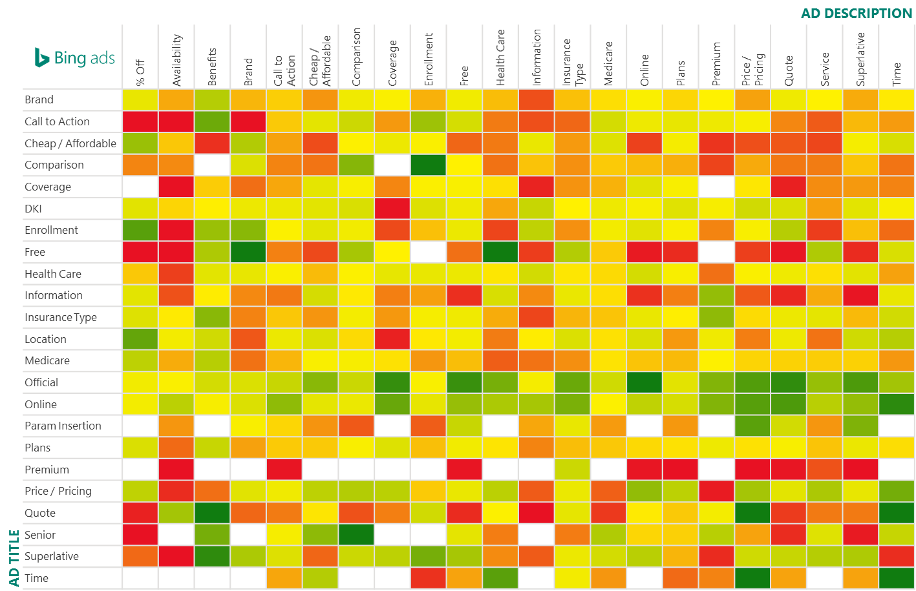
Words that work // Health Insurance
Great
Good
Bad
Insufficient data
Source: Microsoft Internal Data. Total Impressions Generated = 30 Million, Total Ads Analyzed = 56k, Analysis Period = 16 August 2015 – 31 January 2016.
Note: These categories represent groups of similar keywords.

Slide 32
Top 5 ad combinations by device // Health Insurance
Across Devices | Time | Time | Free | Free | Quote
 | Ad · DisplayURL | Ad · DisplayURL | Ad · DisplayURL | Ad · DisplayURL | Ad · DisplayURL
 | Time | Price/Pricing | Brand | Health Care | Time
PC + Tablet | Official | Official | Official | Official | Online
 | Ad · DisplayURL | Ad · DisplayURL | Ad · DisplayURL | Ad · DisplayURL | Ad · DisplayURL
 | Online | Quote | Free | Superlative | Time
Mobile | Time | Time | Free | Quote | Time
 | Ad · DisplayURL | Ad · DisplayURL | Ad · DisplayURL | Ad · DisplayURL | Ad · DisplayURL
 | Price/Pricing | Time | Brand | Brand | Health Care
Across Devices: For the title Time (e.g., “month”, “may”, “day”), Free (e.g., “free annuity”, “fast free”, “free health”) and Quote (e.g., “quotes”, “get quote”) are the top performing keywords. There’s more variety in the description, with keywords Price/Pricing (e.g., “insurance $”, “rates”, “plans prices”), Brand terms and Heath Care (e.g., “health insurance”, “cost health”, “healthcare gov”) among the good performers.
PC + Tablet: In PC+Tablet ads, a title with Official (e.g., “official”, “official site”) sees high performance. While the description presents more variations like Online (e.g., “plans online”, “enroll online”) and Superlative (e.g., “best health”, fast”, “easy”) to combine for more engaging ads.
Mobile: For Mobile ads, the top performing ad titles are consistent with those for Across Devices, for example Free (e.g., “free”, “free online”). For the description we can take advantage of more variation, like Price/Pricing (e.g., “low $”, “price”, “$ month”) and Heath Care (e.g., “health care”, “health”, “health coverage”), to boost performance.
Source: Microsoft Internal Data. Total Impressions Generated = 30 Million, Total Ads Analyzed = 56k, Analysis Period = 16 August 2015 – 31 January 2016.
Note: These categories represent groups of similar keywords.

Slide 33
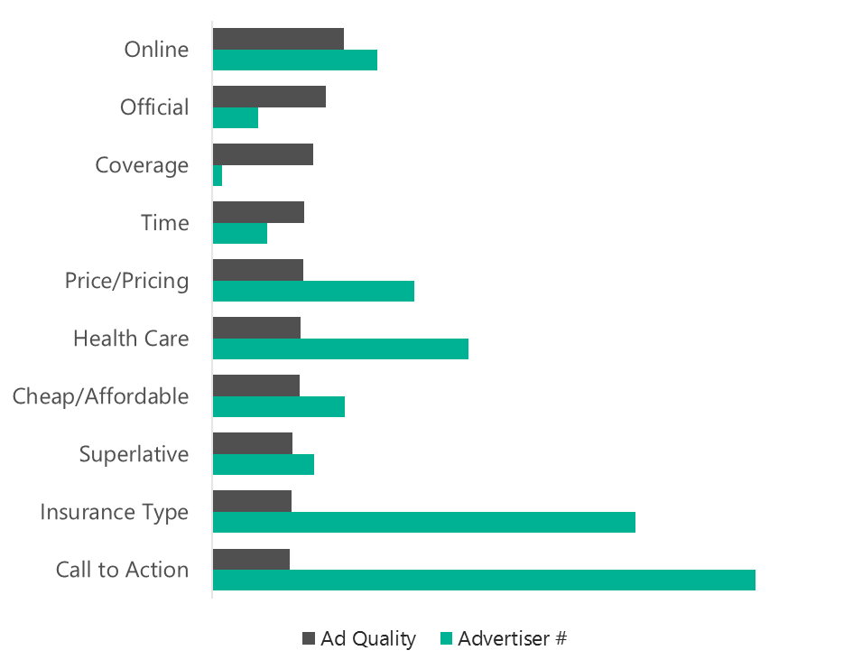
Top performing copy // Sitelink Extensions Health Insurance
Find the sweet spots
Leverage the opportunity where ad quality is high and competition is low
TIP
Health insurance is a very competitive industry when it comes to Sitelink extension performance, leaving very small windows of opportunities. There is some opportunity for Sitelinks related to:
Coverage (e.g., “covered”)
Official
Source: Microsoft Internal Data. Total Impressions Generated = 30 Million, Total Ads Analyzed = 56k, Analysis Period = 16 August 2015 – 31 January 2016.
Note: These categories represent groups of similar keywords.

Slide 34
Why advertise on the Bing Network? Unique audience and purchase behavior Market share in Financial Services Smarter tools to help you achieve more with confidence

Slide 35
Bing Network delivers value for financial services
34M
Business/finance searchers are not reached on Google
44M Total business/finance searchers
190M
Total business/finance searches
42% of business/finance paid clicks
Source: comScore qSearch (custom), US, December 2015; industry categories based on comScore classifications.
Note: All Insurance sub-categories, including Health Insurance, fall under comScore’s Financial Services category and are not broken out separately.

Slide 36
More likely to apply for health insurance Compared with Google, the Bing Network audience is:
7%
more likely to have applied online for health insurance in the last
6 months
5%
more likely to have applied offline for health insurance in the last 6 months
Source: comScore Plan Metrix, US, October 2015, custom measure created using comScore indices and duplication.
October was used to reflect the month prior to health insurance open enrollment period.

Slide 37
More likely to have health insurance Compared with Google, the Bing Network audience is more likely to:
Personally own a health insurance policy
Source: comScore Plan Metrix, US, October 2015, custom measure created using comScore indices and duplication.
October was used to reflect the month prior to health insurance open enrollment period.

Slide 38
Access searchers not reached on Google
27M
Technology
34M
Business & Finance
24M
Education
12M
Telecom
22M
Travel
54M
Retail
Source: Audience data represents Bing Web and Yahoo U.S. Web Search from comScore qSearch (custom), U.S., December 2015. Industry categories based on comScore classifications.

Slide 39
The Bing Network is cost effective for healthcare advertisers
Source: US Marin Software CPC by Vertical Q4 2015.

Slide 40
Increase your ROI by engaging with high-value visitors Remarketing in Paid Search gives you a second chance to turn previous visitors into customers.
How Remarketing in Paid Search works
Visitor
Your website
User added in remarketing list
Visitor leaves
Former visitor searches on Bing or Yahoo
Your ad is served
YOUR AD
USER RETURNS TO YOUR SITE
Easy to get started
Use Universal Event Tracking (UET) tags for both conversion tracking and Remarketing in Paid Search. If you already have a UET tag on your site, you can use the same tag for Remarketing in Paid Search.
High-value audiences
Optimize your campaigns based on user activity on your website, like visiting your home page or abandoning a shopping cart.
Increased ROI
Customize your bids, ads and keywords to target high-value audiences.

Slide 41
Drive even better performance with Ad Extensions
Lift in click-through rates
20%
10%
13%
Location Extensions
Drive more in-store conversions with store locator, click-to-call, merchant ratings, and click-to-direction.
Call Extensions
Connect customers quickly to your business with click-to-call.
Sitelink Extensions
Improve Click-Through Rate (CTR) and conversions by providing direct access to site content and purchase pages.
Source: Microsoft internal data.

Slide 42
Already advertising on Google AdWords?
It’s quick and easy to import your Google AdWords campaigns directly into Bing Ads with just a few clicks.
Learn how to import your campaigns

Slide 43
Connect with a Search Specialist who can help you get started today.
slideshare.net/bingads
instagram.com/bingads
linkedIn.com/company/bing-ads
@bingads
facebook.com/bingads
Call 1-800-518-5689 or check out Getting started
youtube.com/bingads

